Slide 1
Software Engineering
Chapter 1

Slide 2
What is Software ?
Software is a computer program, its associated documents and configuration data which is needed to make these programs operate correctly.
A software system consists of
Number of separate programs, configuration files which are used to set up these programs.
System documentation which describes the structures of the system.
User documentation which explains how to use the system.

Slide 3
Component of software
Software= Programs + Documentation + Operating procedure
Programs
Set of instructions
Documentation
Analysis, Design, Implementation, Testing
Operating procedure
User manuals, operational manuals

Slide 4
What is software engineering?
Software engineering is a discipline whose aim is the production of quality software that is delivered on time, within budget and that satisfies its requirement.
Software engineering is concerned with all aspects of software production.
It is the application of systematics, disciplined, quantifiable approach to the development, operation and maintenance of software.
It enables us to build complex system in a timely manner and with high quality.

Slide 5
Importance of software engineering
Reduce complexity
Minimize software cost
Decrease time
Handling big projects
Reliable software
Effectiveness (describe all by yourself)

Slide 6
Roles of software Engineering
Discuss with system analysts, engineers, programmers and other to design system and to obtain information on project limitations and capabilities performance requirements and interface.
Modify existing software to correct errors, allow it to adapt to new hardware or to improve its performance.
Analyze user needs and needs and software requirement to determine the feasibility of design within time cost constraints.
Coordinate software system installation and monitor equipment functioning to ensure specifications are met.
Consult with customers about software system design and maintenance.

Slide 7
Roles of software Engineering contd….
Design, develop and modify software system using scientific analysis and mathematical model to predict and measure outcome and consequences of design.
Develop and direct software system testing and validation procedures programming and documentation.
Analyze information to determine, recommend and plan computer specification and layouts and peripheral equipment modification.

Slide 8
Software development life cycle(SDLC)
Software development is the process of developing software through successive phase in an order way.
It is also called as software development .

Slide 9
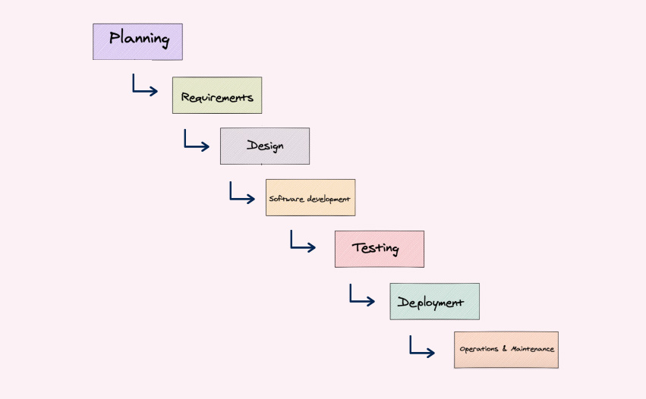
Phases of software development life cycle.

Slide 10
Planning
In the planning phase, project leaders evaluate the terms of the project. This includes calculating labor and material costs, creating a time table with a target goals and creating the projects teams and leadership structure. Planning should clearly define the scope and purpose of the application.
Define requirement
Define requirements is considered part of planning to determine what the application is supposed to do and its requirements. Requirements also included the resources needed to build the project.
Design
The design phase models the way a software application will work. It includes architecture, user interface, platforms, programming, communications etc. It demonstrate a basic idea of how the applications looks and works . This “hands-on” design can be shown to stakeholders, use feedback and improve the applications.

Slide 11
Software development
This is the actual writing of the program. A small project might be written by a single developers, while a large project might be broken up and worked by several teams. Use an access control or source code management applications in this phase.
Testing
It’s critical to test an application before making it available to users. Testing should ensure that each function works correctly. The testing phase helps reduce the number of bugs and glitches that user encounter. This leads to a higher user satisfaction and better usage rate.

Slide 12
Deployment
In the deployment phase, the application is made available to user. Many companies prefer to automate the deployment phase. This can be simple as payment portal and download links on the company website. It could also be downloading an applications on a smartphone.
Operations and Maintenance
At this point, the development of software is almost finished. The application is done and being used in the field. In this phase discover bugs that weren’t found during testing. These error need to be resloved

Slide 13
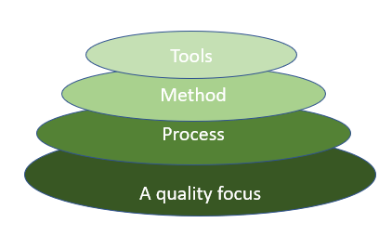
Software development layer

Slide 14
Software process model
A software process model is a development strategy that encompasses the process, methods and tools layer.
A software process model is an abstract representation of a process.
It represents a description of a process from some particular perspective.

Slide 15
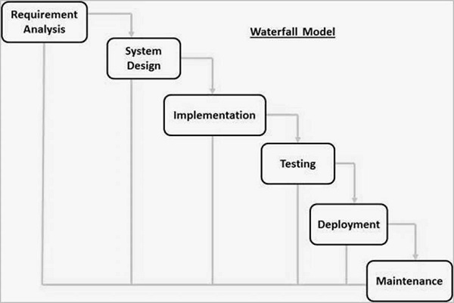
1. Waterfall model

Slide 16
Waterfall model was the first software process model to be used widely in software engineering to ensure success of the project.
The whole process of the software development is divided into separate phase.
The outcomes of one phase act as the input for the next phase sequentially.
Here the progress are seen as flowing steadily downward (like a waterfall) through the phases.
The next phase is started only after the defined set of goal are achieved for previous phase.
The phases do not overlap.
The phases are: (describe yourself)
Requirement analysis
System design
Implementation
Testing
Deployment
maintenance

Slide 17
Advantage and disadvantage
Advantage
Simple and easy to understand.
Phases are processed and completed one at a time.
Works well for smaller project where requirements are very well understand.
Easy to manage and arrange task due to rigidity of the model.
Disadvantage
High amount of risk and uncertainty.
Not used for complex and object oriented projects.
Difficult to measure progress within stages.
Not suitable for accommodating any changes.

Slide 18
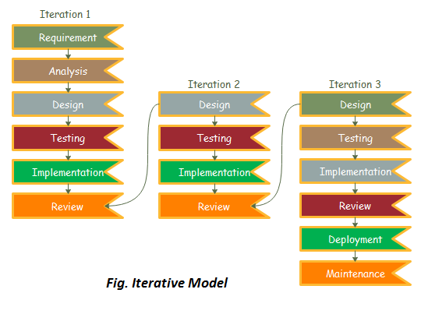
2. Iterative model

Slide 19
In this model, you can start with some of the software specification and develop the first version of the software.
After the first version, if there is a need to change the software, then new version of the software is created with a new iteration.
Every delivery of the iterative model finishes in an exact and fixed period that is called iteration.
The iterative model allows the accessing earlier phase.
The final output of the project renewed at the end of the SDLC process.
The various phases of iterative model are ( describe your self )
Requirement analysis
System design
Implementation
Testing
Review
Deployment
Maintenance

Slide 20
Advantage and disadvantage
Advantage
Testing and debugging during smaller iteration is easy.
Parallel development can plan.
It is easily acceptable to ever changing need of the project.
Risk are identified and resolved during iteration.
Disadvantage:
Not suitable for smaller projects.
More resources may be required.
Design can be changed again and again.
Changes in design can cause over budget.

Slide 21
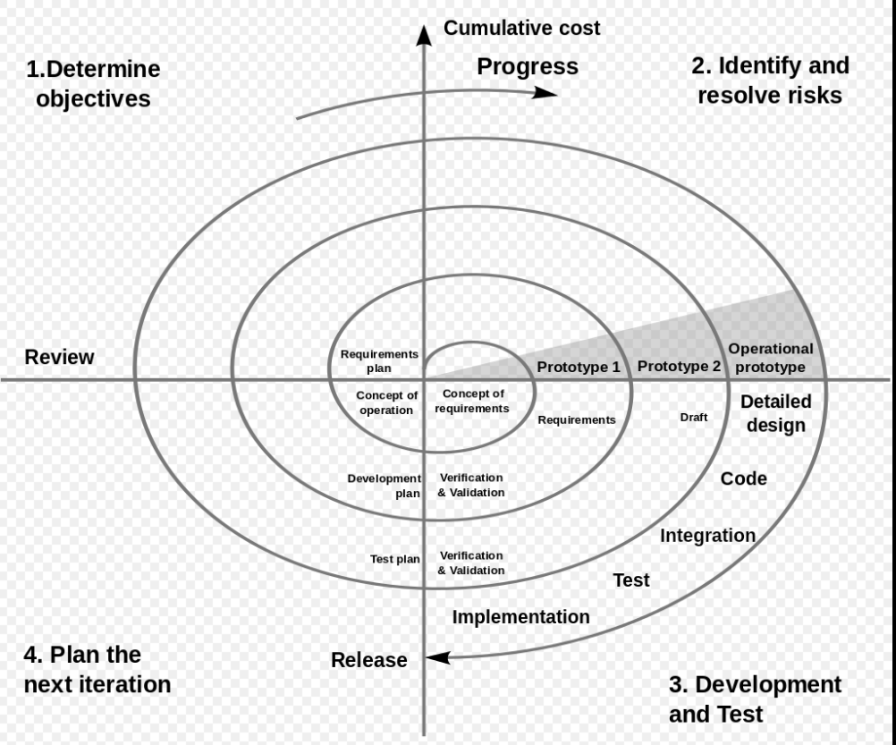
3. Spiral model

Slide 22
It is also called meta model because it use multiple model (waterfall model, iterative model and prototyping model).
It uses prototyping as a risk reduction mechanism and retains the systematic step wise approach of the waterfall model.
Spiral model is one of the important software process models which support for risks handling.
It looks like spiral with many loops.
The exact number of loops of the spiral is unknown and can vary from project to project.
Each loop of the spiral is called a phase of the software development process.
The exact number of phases needed to develop the product can be varied by the project manager depending upon the project risks.
The radius of the spiral represents cost and angular dimension represents the progress.

Slide 23
The phases are:
Objective determination and identify alternative solutions.
Identify and resolve risks.
Develop next version of the product.
Review and plan for the next iteration.

Slide 24
Advantage and disadvantage
Advantage
Risks handling ability.
Good for large and complex project.
Changing requirements can be accommodated
Flexibility in requirement and customer satisfaction.
Disadvantage
Expensive and time taking.
Not suitable for a smaller and simple projects
Difficulty in time management

Slide 25
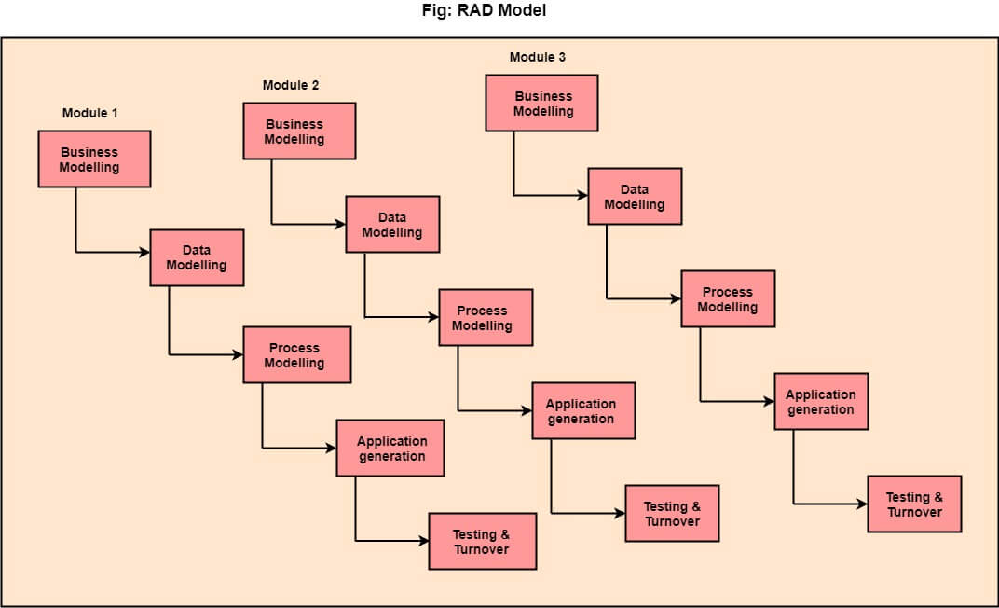
4. Rapid application Development model (RAD)

Slide 26
RAD is an incremental software development process model with extremely short development cycle (60-90 days).
In RAD model, the functional modules are developed in parallel as prototypes and are integrated to make the complete product for faster product delivery. So, there is no detailed preplanning.
It makes easier to incorporate the changes within the development process.
RAD projects follow iterative and incremental model and have small teams comprising of developers, domain experts, customer representative and other IT resources working progressively on their component.

Slide 27
The phases of RAD model are
Business modelling
The information flow among the business function is modeled to answer the following question.
What information process the business process ?
What information is generated ?
Who generates it ?
Where does the information go ?
Who process it ?
Data modelling
The information defined in the business modelling phase is refined into a sets of data objects that are needed to support the business.
The characteristics (attributes) of each objects are identified and the relationship between these objects is defined

Slide 28
Process modelling
The data objects defined in the data modelling phase are transformed to achieve the information flow necessary to implement a business function.
Processing description are created for adding, modifying deleting or retrieving a data objects.
Application generation
The actual system is built and coding is done by using automation tools to convert process and data models into actual prototypes.
Testing and Turnover
Since RAD process emphasizes reuse, many of the program components have already been tested, that reduces overall testing time.
Testing a new component and interface are done.

Slide 29
Advantage and disadvantage
Advantage
Reduce development time.
Increase reusability of components.
Changing requirement can be accommodated.
Progress can be measured.
Disadvantage
Dependency on technically strong team members for identifying business requirement.
Requires highly skilled developers/designers
Cost of modelling and automate code generation is high.
Management complexity is more.

Slide 30
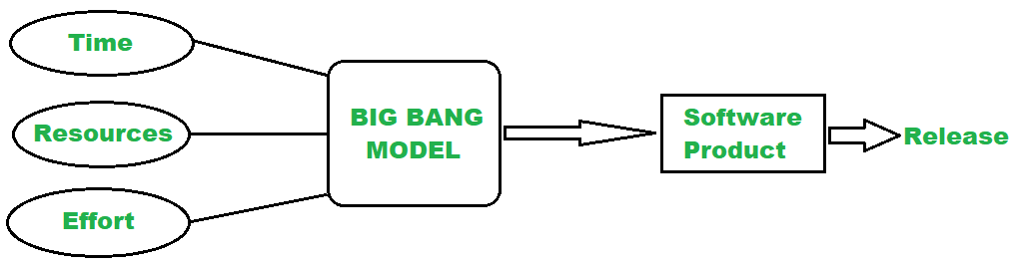
5. BIG bang Model

Slide 31
In this model, developers do not follow any specific process.
Development starts with the required time, money and efforts as input and output is software developed which may or may not be as per customer requirement.
If the customer is not sure about what exactly he want and the requirement are implemented without much analysis.
The model is useful for small projects with one or two developers working together and is also useful for academic or practice projects.

Slide 32
Advantage and disadvantage
Advantage
Very simple model
Little or no planning required
Easy to manage
Very few resources required
Disadvantage
Very high risks and uncertainty
Not good for complex and object oriented projects
If requirement is not clear that can cause very expensive

Slide 33
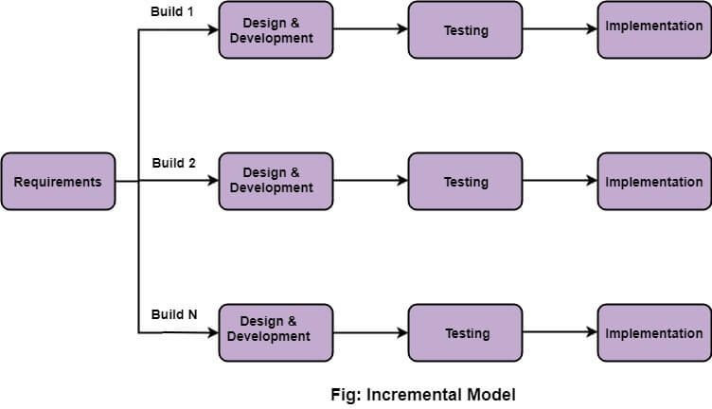
Incremental model

Slide 34
Incremental model is a process of software development where requirements are divided into multiple standalone modules of the software development.
In this model, each modules goes through the requirement, design, implementation and testing phases.
Every subsequent release of the module add functions to the previous release.
The process continues until complete system is achieved.
The various phases are:
Requirement analysis
Design and development
Testing
Implementation

Slide 35
Advantage and disadvantage
Advantage
Error are easy to recognized.
Easier to test and debug.
More flexible.
Simple to manage risks.
Disadvantage
Need for good planning
Total cost is high.
Well defined module interfaces are needed.

Slide 36
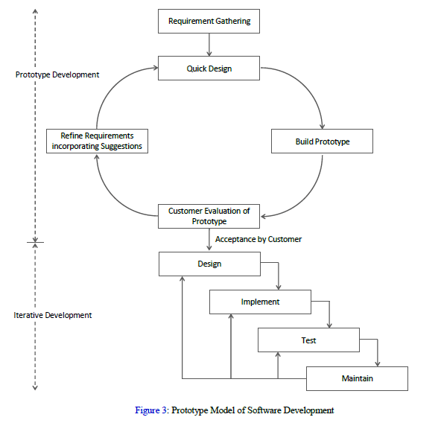
6. Prototype model

Slide 37
Prototype model is a software development model in which prototype is build, tested and reworked until an acceptable prototype is achieved.
It also creates base to produce the final system or software.
It works best in scenarios where the project requirement are known in detail.
It is an iterative, trial and error method which takes place between developer and client.
Also known as toy model (domy model).
Missing functionality can be identified which help to reduce the risk of failure.

Slide 38
The phases of prototype model are
Requirement Gathering
Quick design
Build prototype
Customer evaluation
Refine requirement incorporating customer suggestion.
Iterative development.

Slide 39
Advantage and disadvantage
Advantage
Users are actively involved in development.
Customer satisfaction
Support early product marketing
Error are detected much earlier.
Disadvantage
Slow and time taking process.
Cost of developing is very high.
Poor documentation because requirement of customer are changing.
Very difficult for developers to accommodate change demanded by the customer.

Slide 40
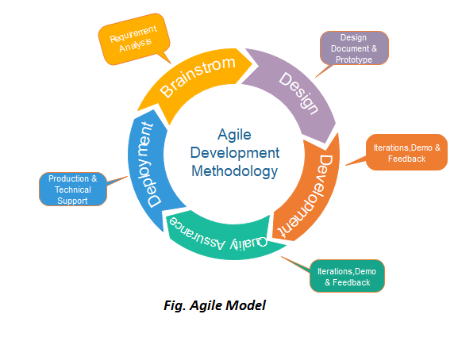
7. AGIle mode

Slide 41
Agile is a combination of iterative and incremental process model with focus on process adaptability and customer satisfaction by rapid delivery of working software product.
Agile methods break the product into small incremental builds.
These builds are provided in iteration.
Each iteration typically lasts from about one to three weeks and every iteration involves cross function teams working simultaneously on various areas like planning, requirement analysis, design, coding, unit testing, acceptance testing.
In agile, the tasks are divided into time boxes (small time frames) to deliver specific features for a release.
The agile thought process had started early in the software development started becoming popular with time due to its flexibility and adaptability.
Following are the agile manifesto principles
Individuals and iterations
Working software
Customer collaboration
Responding to change

Slide 42
Advantage and disadvantage
Advantage
Very realistic approach to software development.
Promotes team work and cross training.
Functionality can be developed rapidly and demonstrated
Resources requirements are minimum.
Easy to manage.
Gives flexibility to developers.
Disadvantage
Not suitable for handling complex dependencies.
More risks of sustainability, maintainability and extensibility.
Less documentation

Slide 43
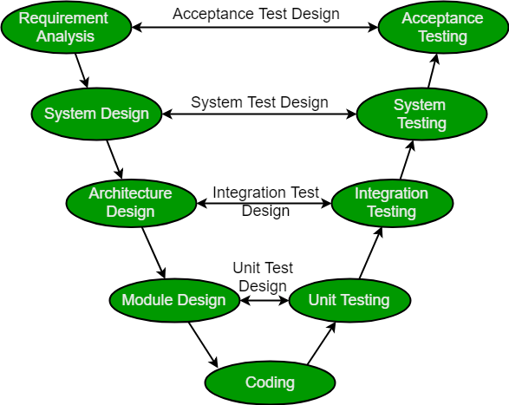
V-Model

Slide 44
V- model is also known as verification and validation model.
The V-model is an extension of waterfall model and is based on the association of a testing phase for each corresponding development stage.
This is highly disciplined model and the next phase starts only after the completion of the previous phase.
In V-model the testing phase and the development phase is planned in parallel.
There are verification phase on one side and validation phase on other side and coding phase joins two sides of V-model.

Slide 45
Verification phase:
Business requirement analysis
System design
Understand and detailing the complete hardware and communication setup system test plan designed.
Architectural design
Technical and financial feasibility
System design is broken down into modules
High level design.
Integration test plan is designed
Module design
Low level design
Internal module design
Unit test plan
Coding

Slide 46
Validation phase (describe yourself)
Unit testing
Integration testing
System testing
Acceptance testing

Slide 47
Advantage and disadvantage
Advantage
Time saving
Good understanding of project in the beginning
Every component must be testable
Progress can be tracked easily
Proactive defect tracking
Disadvantage
No feedback so less scope of changes.
Risk analysis not done.
Not good for big or object oriented project

Slide 48
Attributes of good software
Acceptability
Software must be acceptable to the type of users for which it is designed.
This means that it must be understandable, usable, and compatible with other systems that they use.
Dependability and security
Software dependability includes a range of characteristics including reliability, security, and safety.
Dependable software should not cause physical or economic damage in the event of system failure.
Software has to be secure so that malicious users cannot access or damage the system

Slide 49
contd..
Efficiency
Software should not make wasteful use of system resources such as memory and processor cycles.
Efficiency therefore includes responsiveness, processing time, resource utilization, etc
Maintainability
Software should be written in such a way that it can evolve to meet the changing needs of customers.
This is a critical attribute because software change is an inevitable requirement of a changing business environment.
.

Slide 50
Characteristics of A quality software
1. Correctness
Correctness is important for good software. There shouldn’t be faults with specification, design or implementation.
2. Usability
Users should be able to learn and use a system easily.
3. Efficiency
The less resource a piece of software uses, the better. Processor, memory and disk space usage should be minimized.

Slide 51
4. Reliability
A system that can perform the required functions stably is important. Failures should be as rare as possible.
5. Integrity
Security should be taken into account. Our software should let attackers access unauthorized resources.
Also, data validation is important so that bad data can’t be saved into the system.
6. Adaptability
A system that can be used without modification for different situations it’s good.

Slide 52
7. Accuracy
The accuracy of its outputs is good. This measures if the software outputs the right results for users.
8. Robustness
If a system is still working after getting invalid inputs and stressful environmental conditions, then it’s good for our system.
9. Maintainability
The ease in which an existing system can be changed is important. The easier that we can make changes, the better

Slide 53
10. Portability
A system that operates in different environments from which it’s originally designed makes it good.
11. Reusability
The more reusable parts that a piece of software has, the better.
Using reusable parts means that we don’t have to reuse them from scratch.
12. Readability
Easy to read code is easy to change code. If we understand them faster, then we can make changes faster and in a less error-prone way.

Slide 54
13. Testability
Making our software system testable is critical. If our code is easy to write unit tests for, then that’s good.
14. Understandability
The ability for us to understand our system in a global view or at the detailed code level is important

Slide 55
Difference between Software engineering and system engineering
S.N | SYSTEM ENGINEERING | SOFTWARE ENGINEERING
1 | System engineering deals with the overall management of engineering projects during their life cycle | Software engineering deals with the designing and developing good quality of software applications/software products.
2 | System engineering mostly focus on users and domain | Software engineers mostly focus on developing good software.
3 | It ensure correct external interfaces, interface among subsystem and software. | It makes interfaces among software module, data and communication path work.
4 | System engineering requires a broader education background like engineering, mathematics and computer science etc. | Software engineering requires computer science or compute engineering background.

Slide 56
Challenges of software engineering

Slide 57
1. Heterogeneity
Increasingly, system are required to operate as distributed systems across networks that include different types of computer and mobile devices.
As well as running on general purpose computer software may also have to execute on mobile phone.
You often have to integrate new software with older legacy system written in different programming languages.
The challenge here is to develop techniques for building dependable software that is flexible enough to cope with heterogeneity.

Slide 58
2. Business and social change
Business and society are changing incredibly quickly as emerging economics develop and new technologies become available.
They need to be able to change their existing software and to rapidly develop new software.
Many Traditional software engineering Techniques are time consuming and delivery of new system often takes longer than plan
They need to evolve so that the time required for software to deliver value to its customer is reduced.

Slide 59
3. Security and trust
As software is intertwined with all aspects of our lives, it is essential that we can trust that software.
This is especially true for remote software system accessed through a web page or web services interface
We have to make sure that malicious user cannot attack our software that information security is maintained

Slide 60
Assignment
Write about the software engineering ethics.

Slide 61
Thank you

